Slide 1

Suburban Cook County Health Atlas Overview meeting with Dr. LaMar Hasbrouck
August 11, 2022
Notes:
This project lists the

Slide 2
TODAY’s Agenda
INTRODUCTIONS
- CCDPH
- Population Health Analytics Metrics and Evaluation (PHAME) Center at UIC
- METOPIO
PRESENTATION
- OVERVIEW
HEALTH ATLAS
- DEMONSTRATION
FEEDBACK
- QUESTIONS FOR DR. HASBROUCK
NEXT STEPS
LAUNCH DATE
COMMUNICATION PLAN
CCDPH, CCH, UIC
Notes:
Show homepage and pick chronic disease – trend over time, by municipality, map, age, race, and sex

Slide 3
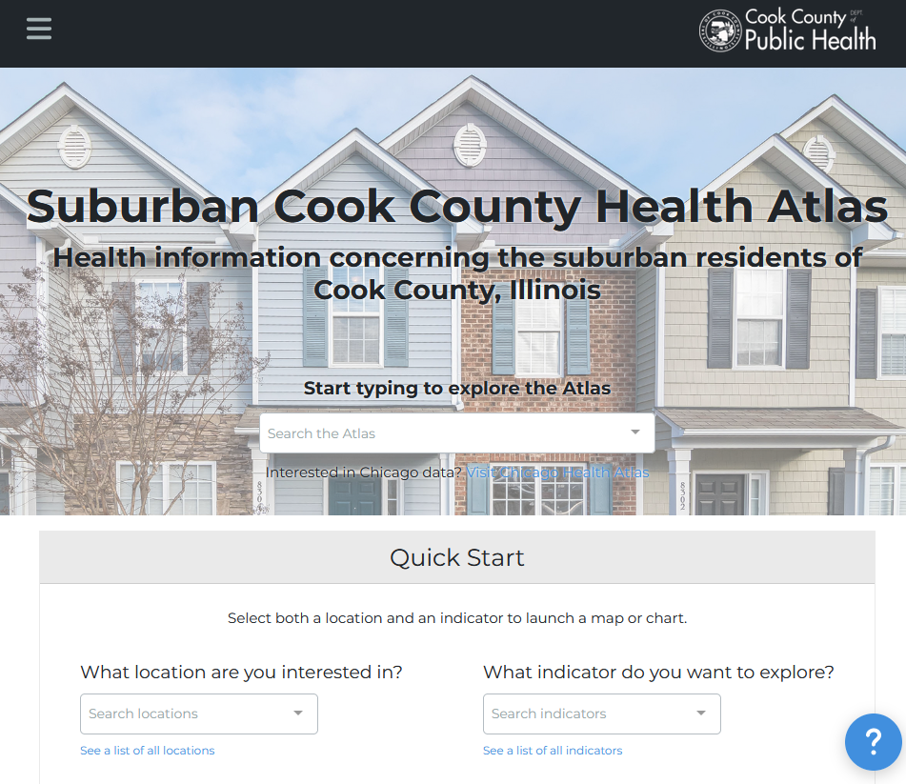
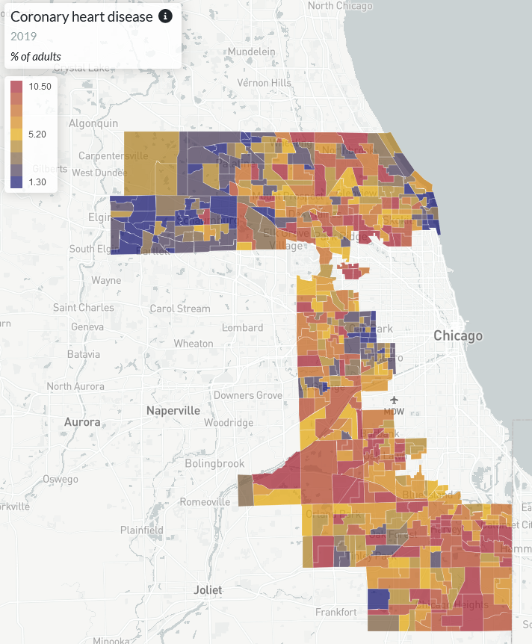


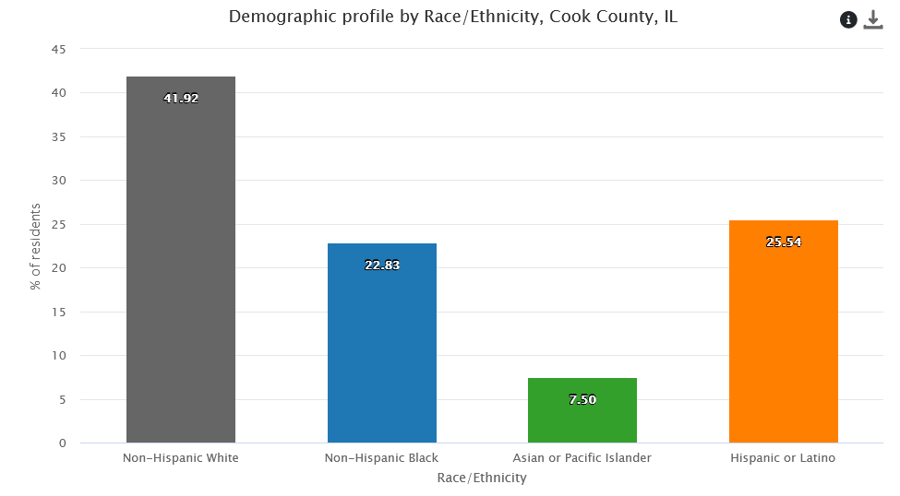
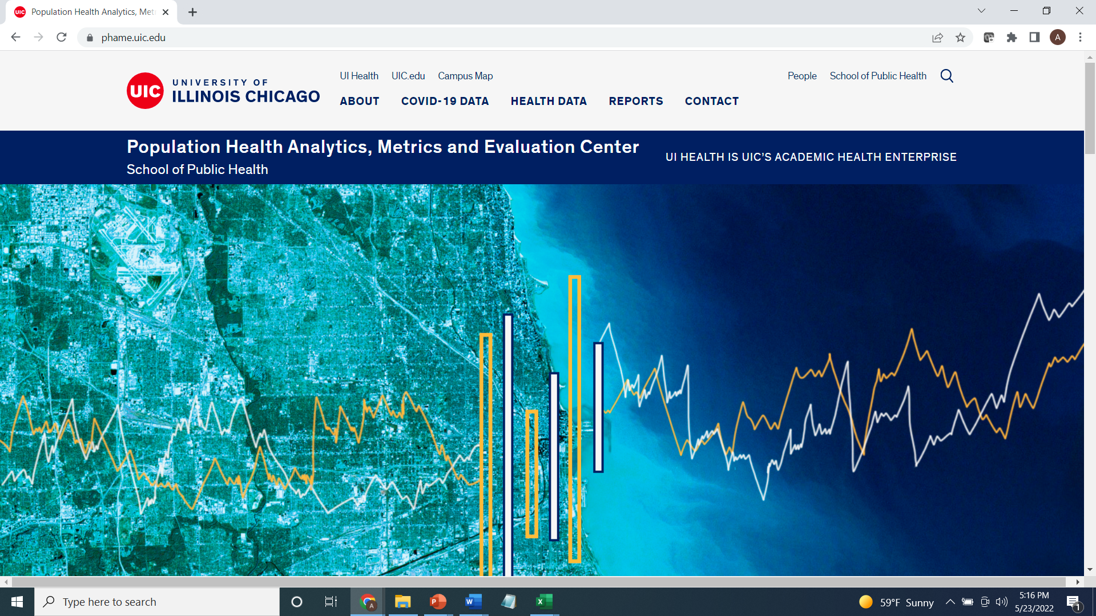
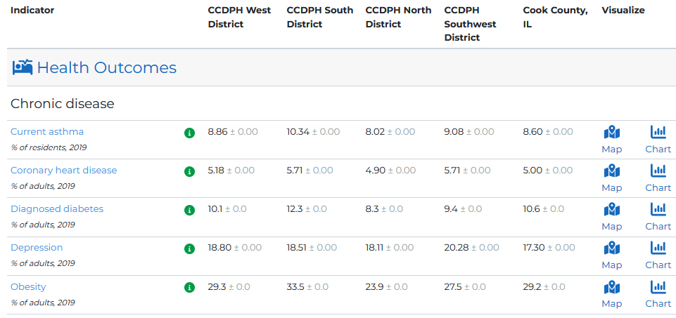
SUBURBAN COOK COUNTY HEALTH ATLAS
Using startup funds from CDC’s Health Equity Grant, CCDPH’s Epidemiology Unit is collaborating with UIC’s PHAME Center and Metopio to design and deploy an innovative, online atlas for exploring and sharing health information concerning the suburban residents of Cook County. The atlas allows stakeholders to examine, visualize and download health data using maps, charts and tables.
Notes:
The Cook County Department of Public Health’s Epidemiology Unit is leading an effort to design and deploy an online health atlas for suburban Cook County. We envision the atlas to be a platform for sharing a wealth of information to improve health awareness and decision-making. We are consulting with public health experts, working with other units within the department and reaching out to community members to identify what data to include.
In addition, the atlas contains several quality of life and risk indices related to public health that combine indicators across the six categories (e.g., social vulnerability index, index of concentration of extremes, neighborhood deprivation).

Slide 4
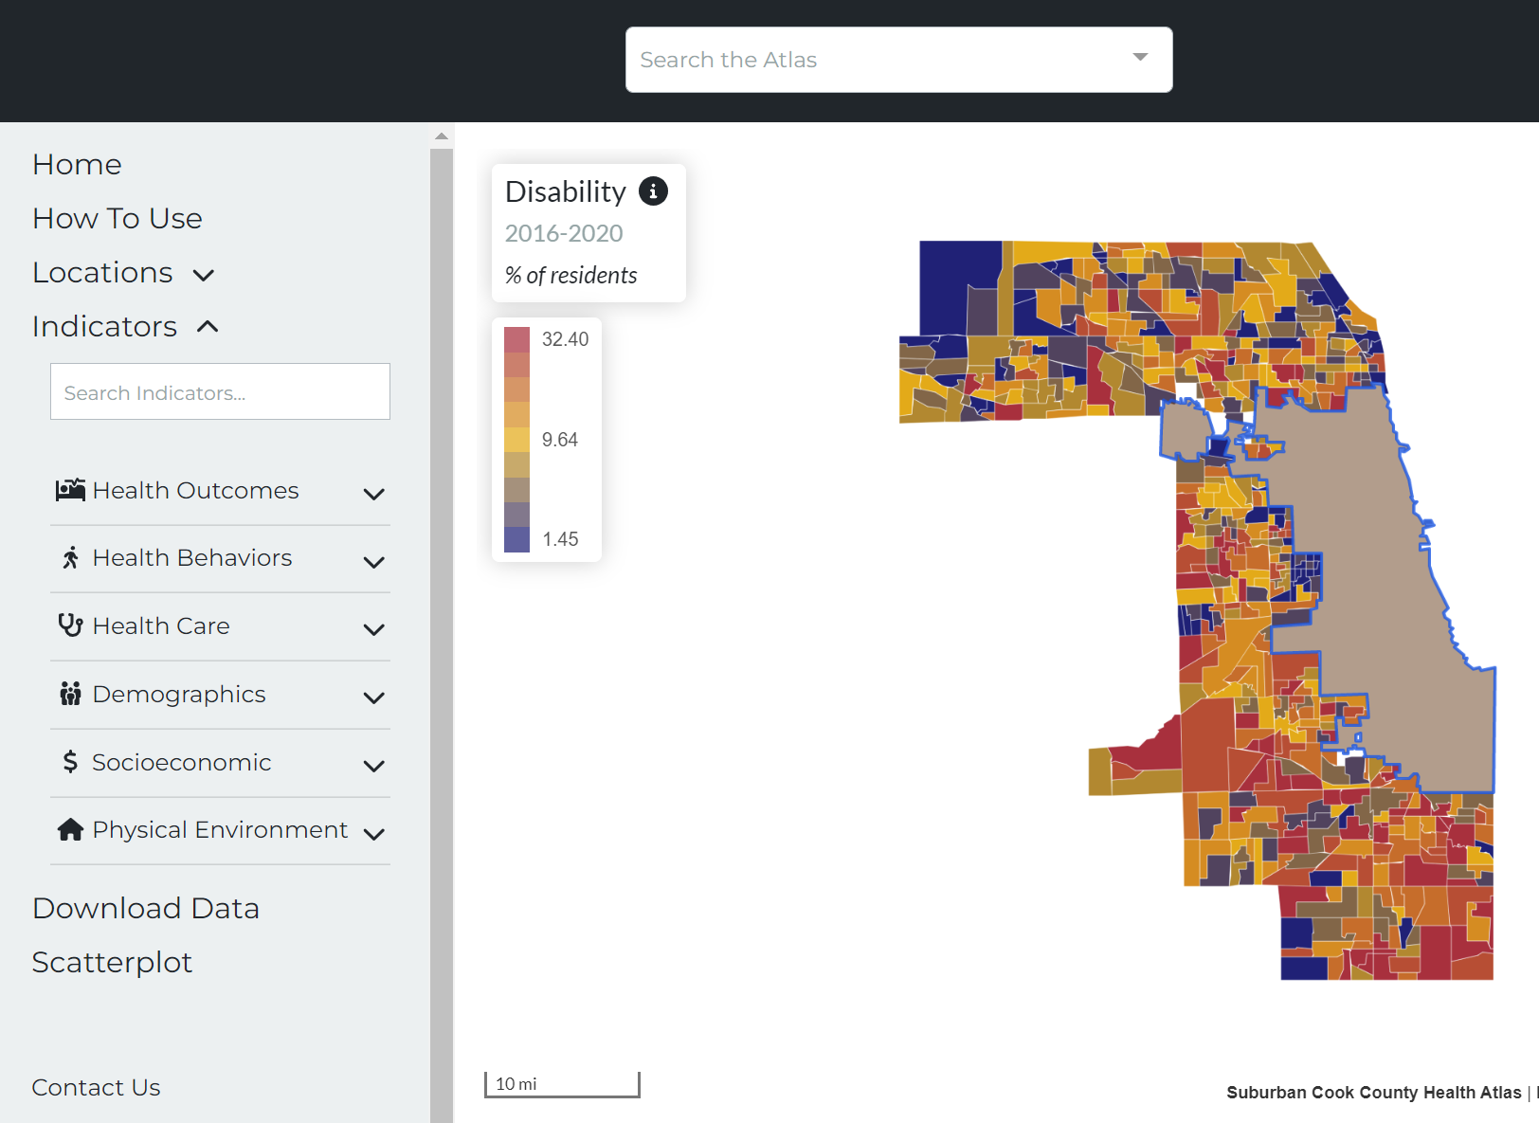
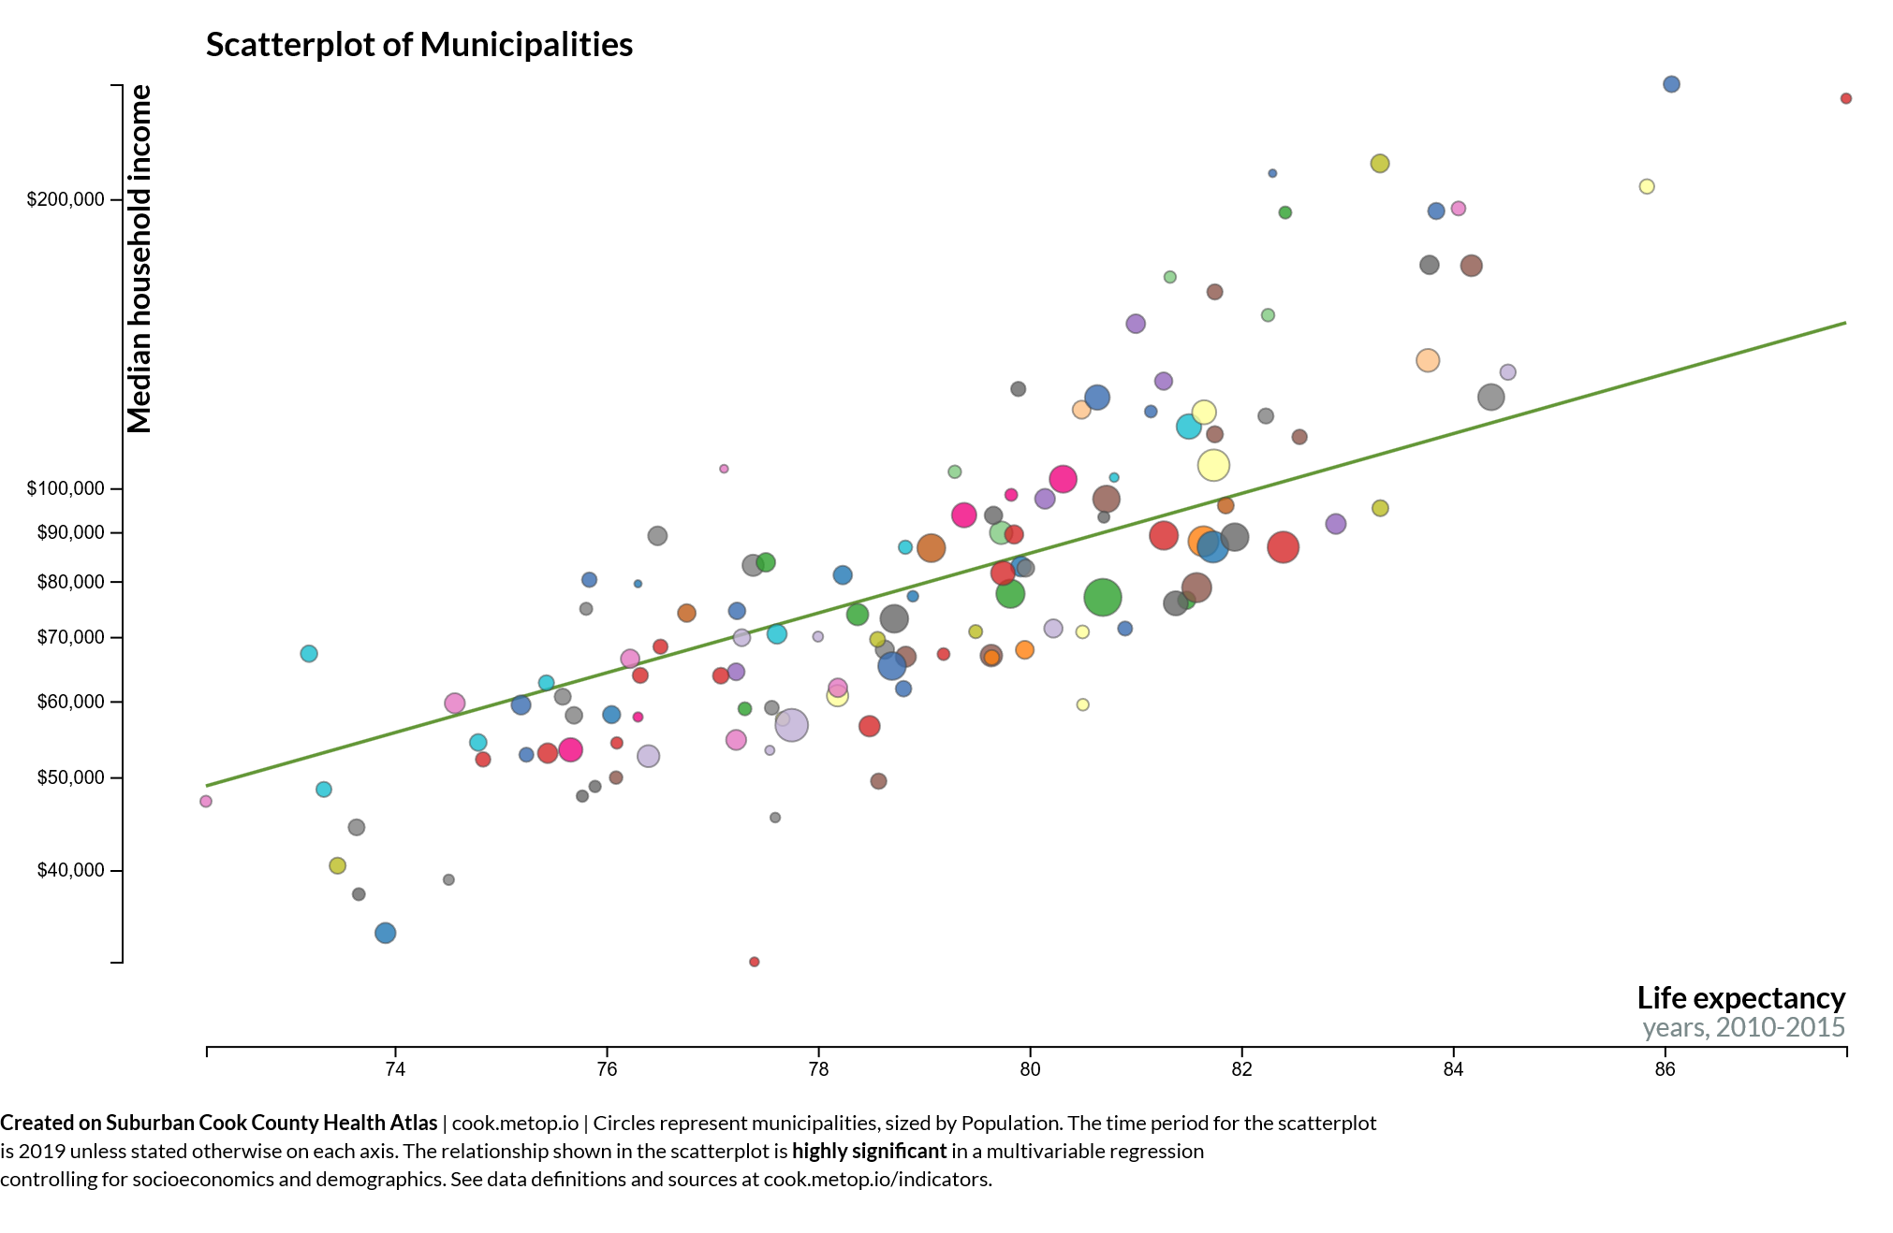
PURPOSE OF THE HEALTH ATLAS & PARTNERSHIP
DATA ACCESS
Importance of hyper local data.
Reaching target audiences.
Incorporating health care data.
COORDINATION AND ALIGNMENT WITH CDPH
Data interoperability between departments.
Sharing survey results.
GOVERNANCE MEETINGS WITH LEADERSHIP
Meets twice each year with leadership and funders to provide strategic advisement.

Slide 5

HEALTH INDICATOR CATEGORIES
Indicators on the health atlas are organized into six primary categories.
HEALTH OUTCOMES
DEMOGRAPHICS
Consequences, complications and other outcomes that result from disease (e.g., injury, hospitalization, death).
Population characteristics including community size, composition and structure (e.g., population, age, gender, race/ethnicity, migration).
The platform integrates several types of data
HEALTH BEHAVIORS
SOCIOECONOMIC
Individual activities that influence health (e.g., alcohol, drug and tobacco use; diet, physical activity, sleep).
Social and economic factors that can affect health (e.g., income, employment, education, segregation).
HEALTH CARE
PHYSICAL ENVIRONMENT
Systems and services for administering care (e.g., health screenings; primary, prenatal and dental care; clinics, hospitals, FQHCs).
Characteristics of the places where individuals where individuals live, learn, work, and play (e.g., parks, housing, air quality, water quality and transportation)
Notes:
The Cook County Department of Public Health’s Epidemiology Unit is leading an effort to design and deploy an online health atlas for suburban Cook County. We envision the atlas to be a platform for sharing a wealth of information to improve health awareness and decision-making. We are consulting with public health experts, working with other units within the department and reaching out to community members to identify what data to include.
In addition, the atlas contains several quality of life and risk indices related to public health that combine indicators across the six categories (e.g., social vulnerability index, index of concentration of extremes, neighborhood deprivation).

Slide 6
HEALTH INDICATOR SUB-CATEGORIES
The six primary indicator categories are further broken down into several subcategories.
HEALTH OUTCOMES
PHYSICAL ENVIRONMENT
HEALTH BEHAVIORS
SOCIO-ECONOMIC
Chronic disease
Infectious disease
Injury and violence
Maternal & child
Community safety
Housing
Transportation
Pollution exposure
Environmental risk
HEALTH CARE
DEMO-GRAPHICS
Income
Education
Employment & occupation
Public assistance
Alcohol & drug use
Tobacco use
Diet & exercise
Sexual activity
Population age
Sex & gender
Race, & ethnicity
Household structure
Language
Migration status
Access to care
Quality of care
Facility utilization

Slide 7
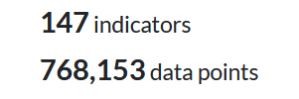
health atlas FIRST YEAR DATA RELEASE TIMELINE
The atlas will be continually updated with the latest public health information for suburban Cook County. The rollout of the data over the first year will proceed in four phases. With each phase, the Epi Unit will reach out to other CCDPH units, the county and community-based contacts for data requests and feedback.
01
02
03
04
As of 8/11/22
PHASE ONE (August 2022)
PHASE TWO
(September 2022)
PHASE THREE
(October 2022)
PHASE FOUR
(Spring 2023)
Select indicators from CCDPH’s latest Community Health Status Assessment; multiple community indices; communicable disease prevalence; opioid deaths
2013 to 2020 birth and death rates by municipality; environmental justice screening data
2018 to 2020 hospitalization inpatient and outpatient data; small area (i.e., census tract) estimates of 2013 to 2020 birth and death statistics
2022 Suburban Cook County Health survey data which includes prevalence estimates by municipality

Slide 8
Feedback
Notes:
WHAT IS YOUR OVERALL IMPRESSION OF THE HEALTH ATLAS?
How does this look and feel to you?
Do you like the picture on the homepage?
If not, what should homepage look like?

Slide 9
Next Steps
Launch Date
Communication Plan – CCH, CCDPH & UIC
Social Media (Twitter, Facebook, LinkedIn)
Press Releases (UIC & CCDPH)
External List Serves ( i.e. UIC Today)
Outreach and Education Plan
Data Advisory Group – For Suburban Cook
Develop measures, track, and evaluate?
Notes:
The purpose of an education session plan for the Cook County Health Atlas is to ensure that residents, community stakeholders, researchers, students, and governmental officials will be able to utilize the platform to its fullest capacity.
TARGET AUDIENCE
Those interested in learning about how to use the Suburban Cook County Health Atlas is the target audience.

